Slide 1

Identity Detection and Recognition
Presentation on:
Presented by:
Coordinated by:
Mr.Aakash Chaudhari
Mr. Ajeet Singh
Mr. Nimish Ukey
Mr. Prashant Dahat
Mr.Rahul Shinde
Mr. Rohit Bansod
Mrs. Vimala Mathew
Scientist/Engineer ‘D’
NIELIT, Calicut

Slide 2
Content
Introduction
Flowchart
Dataset
Output
Purpose / Application
Conclusion

Slide 3
Introduction
Our goal is to train a convolution neural network using keras and deep learning to recognize and classify each of the faces
The main objective of the project is to train and recognize the face of the person using CNN and to detect the faces in an image/video using OpenCV and label him/her with square box along
As a result we are able to determine the facial features of the respective faces in a video dataset

Slide 4
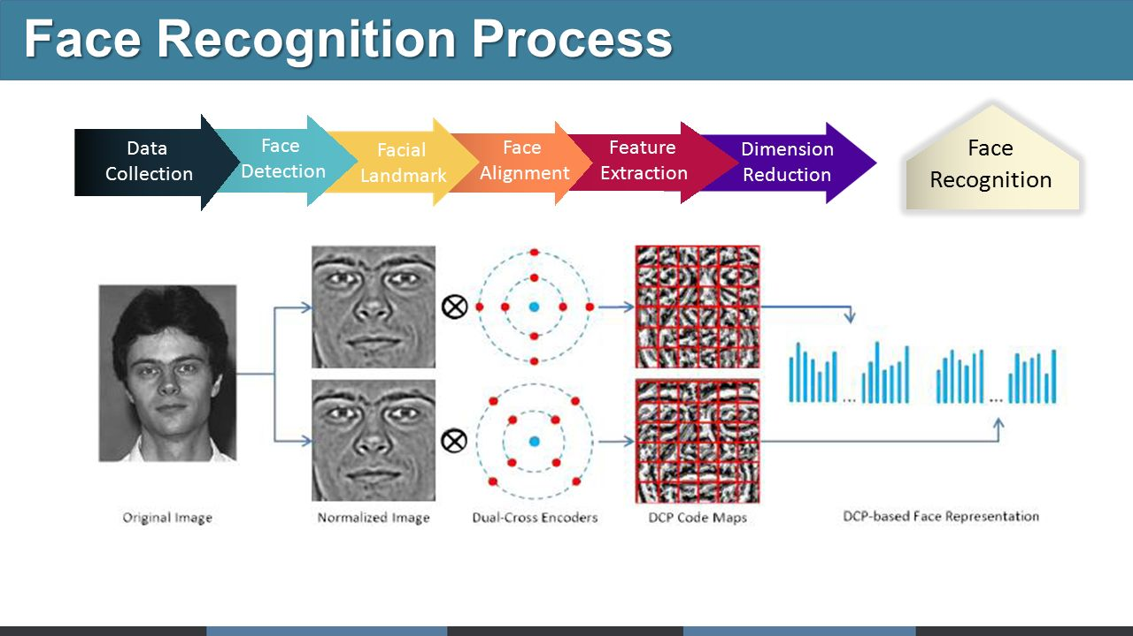
Basic Face Recognition Process

Slide 5
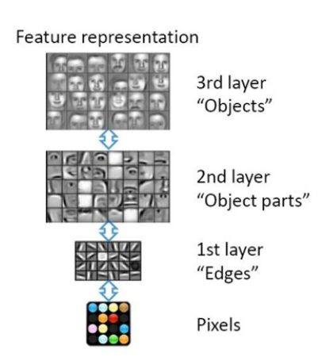
Architecture of face recognition
Natural Progression from low level to high level structure as seen in natural complexity
Easier to monitor what is being learnt and to guide the machine to better sub-spaces
A good lower level representation can be used for many distinct tasks

Slide 6
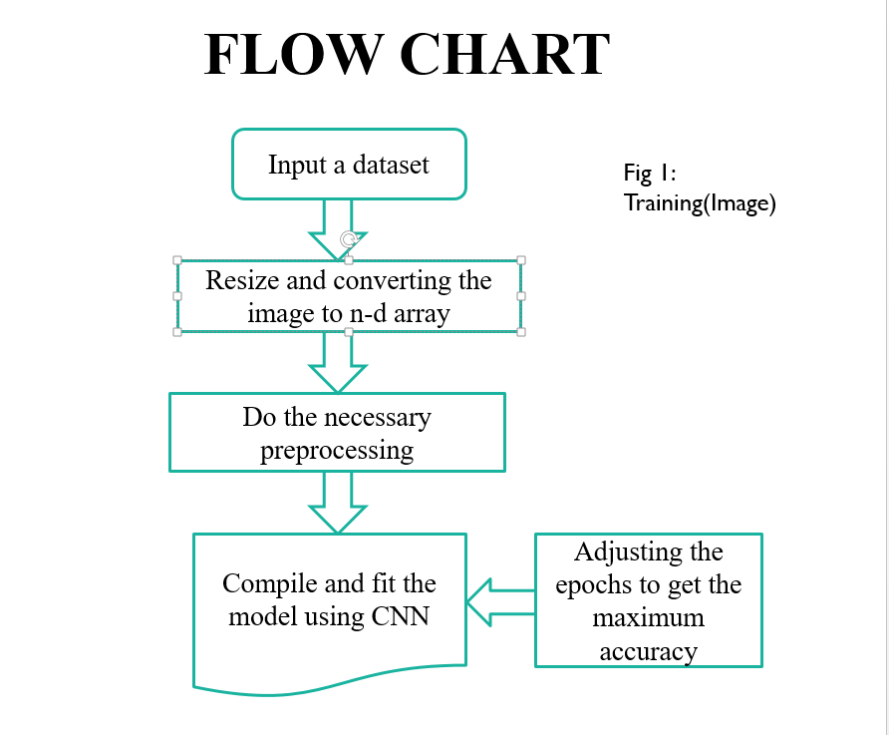

Slide 7
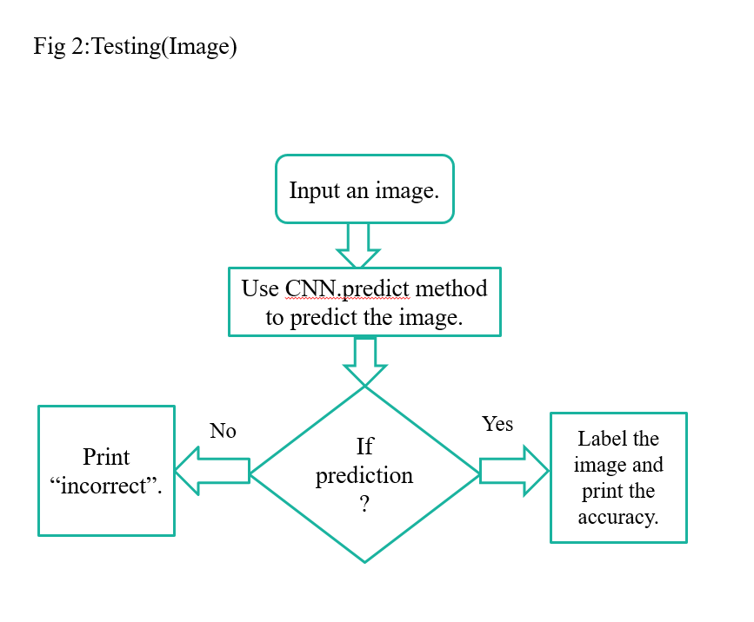

Slide 8
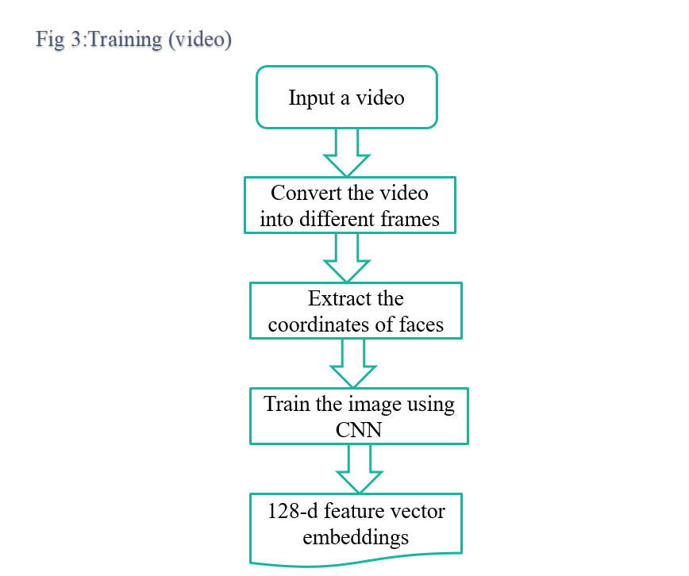

Slide 9
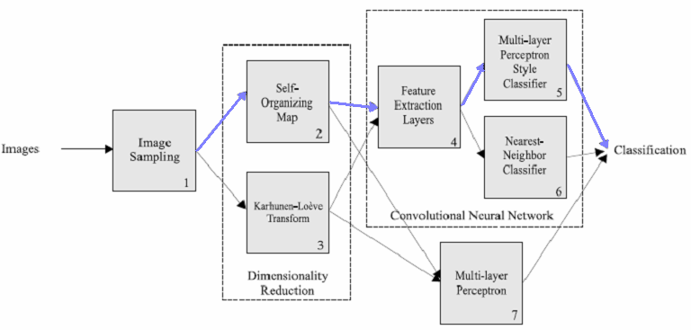
Model Realization

Slide 10
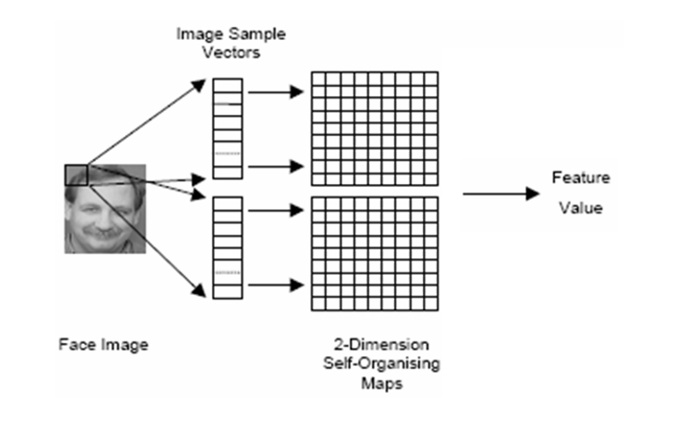
Face Dataset Sampling

Slide 11
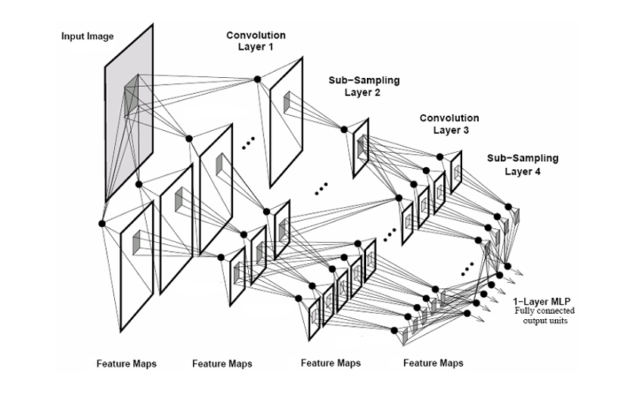
Evolution of CNN layers

Slide 12
CNN and Sub-layers
Convolutional Layer
Each Layer one or more planes
Each Plane can be considered as a feature map which has a fixed feature detector that is convolved with the local window which is scanned over the planes in previous layer.
Subsampling Layers
Local averaging and subsampling operation

Slide 13
Feature Extraction and Recognition

Slide 14
Dataset
Online image capture
Live Video Frame capturing
Customized Dataset

Slide 15
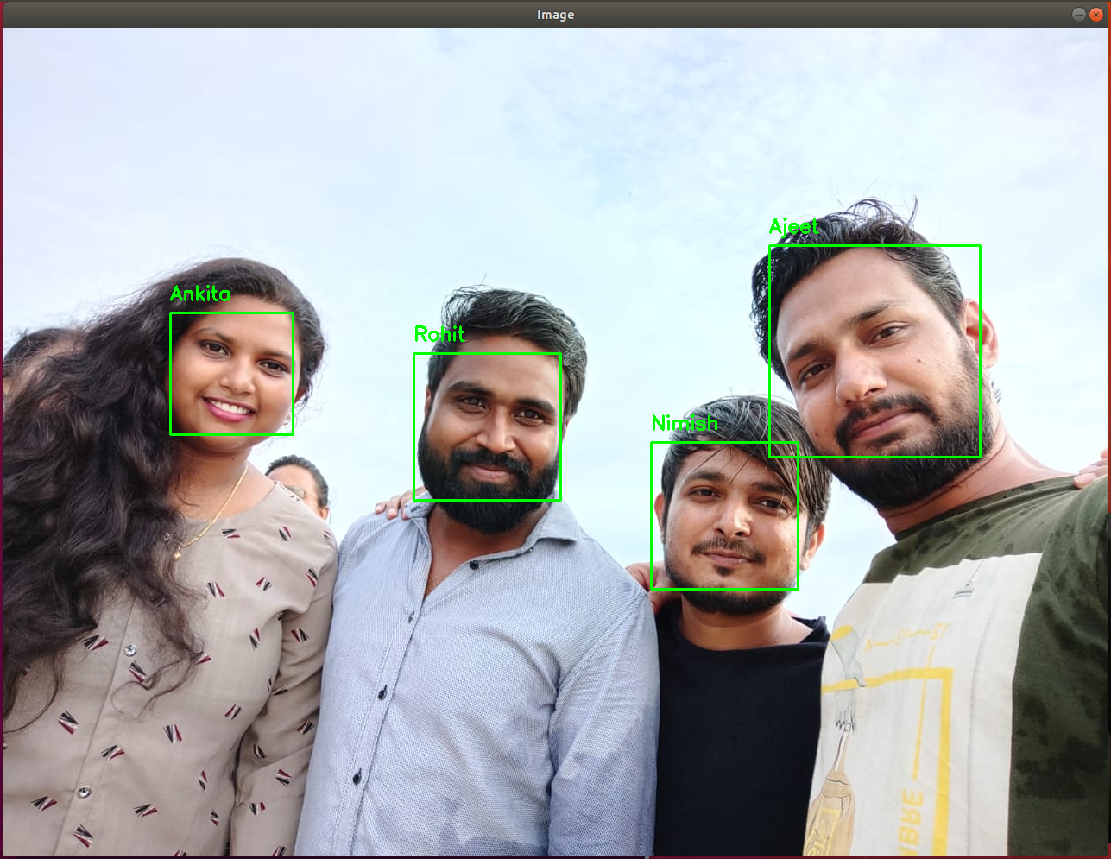
Initialize the model
Load
networks
Capture video stream
Read stream and highlight faces
Add result text to image
Feed input to network and make a forward pass

Slide 16
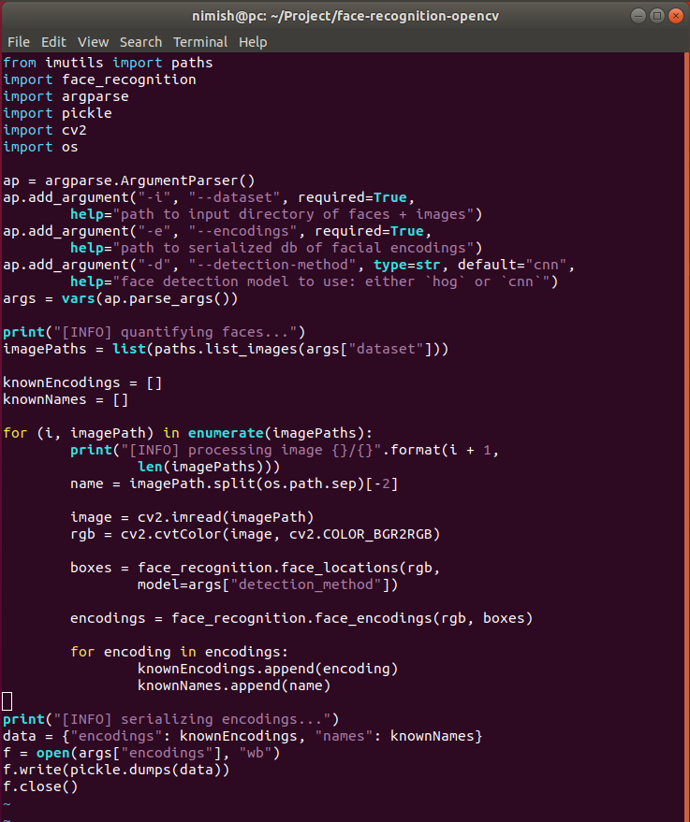
Code:
Encode Faces
Recognise faces in Image
Recognize faces in live video stream
Recognize faces in video file

Slide 17
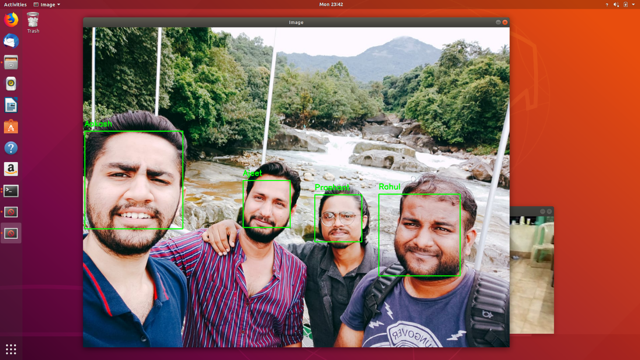
Recognize faces in Image

Slide 18
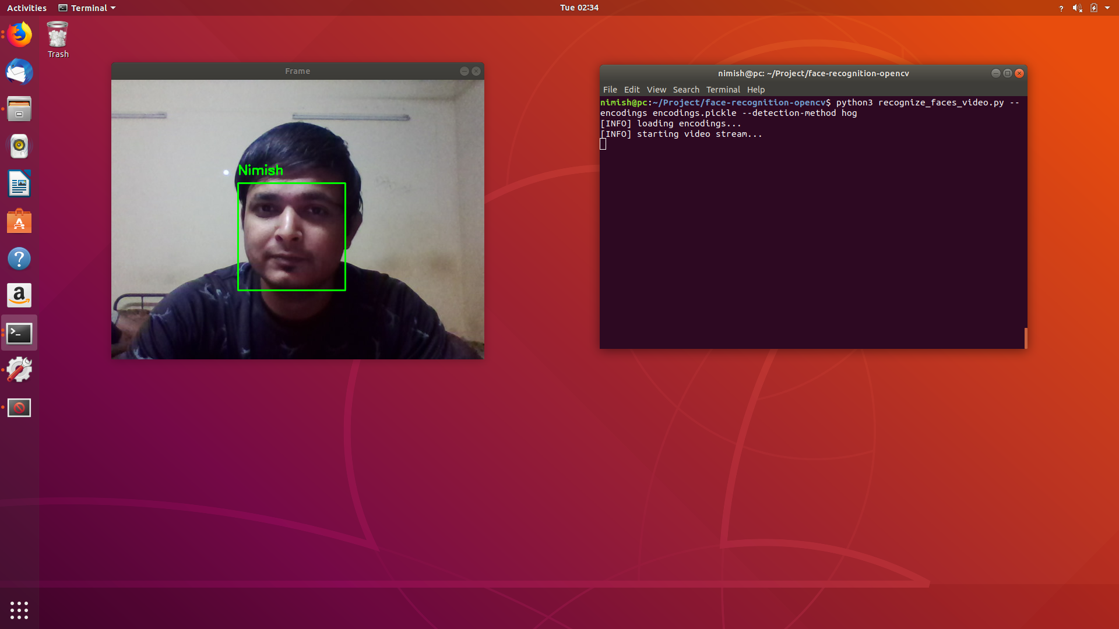
Recognize faces in live video stream

Slide 19
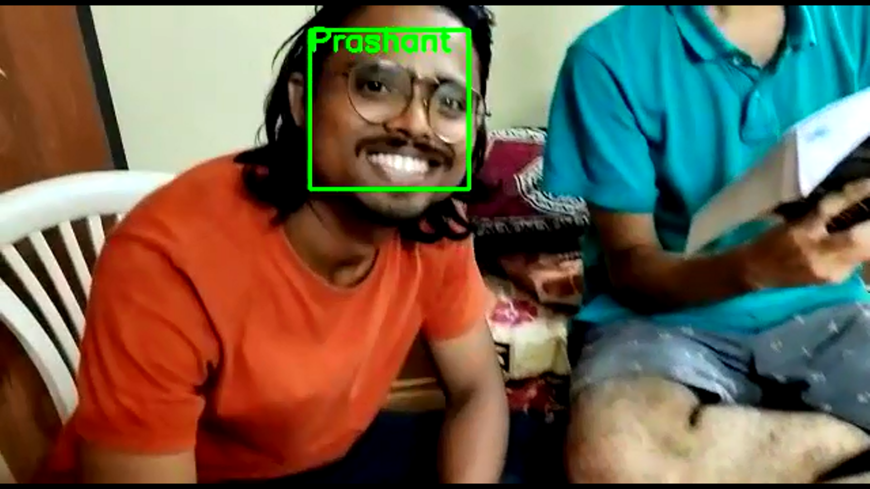
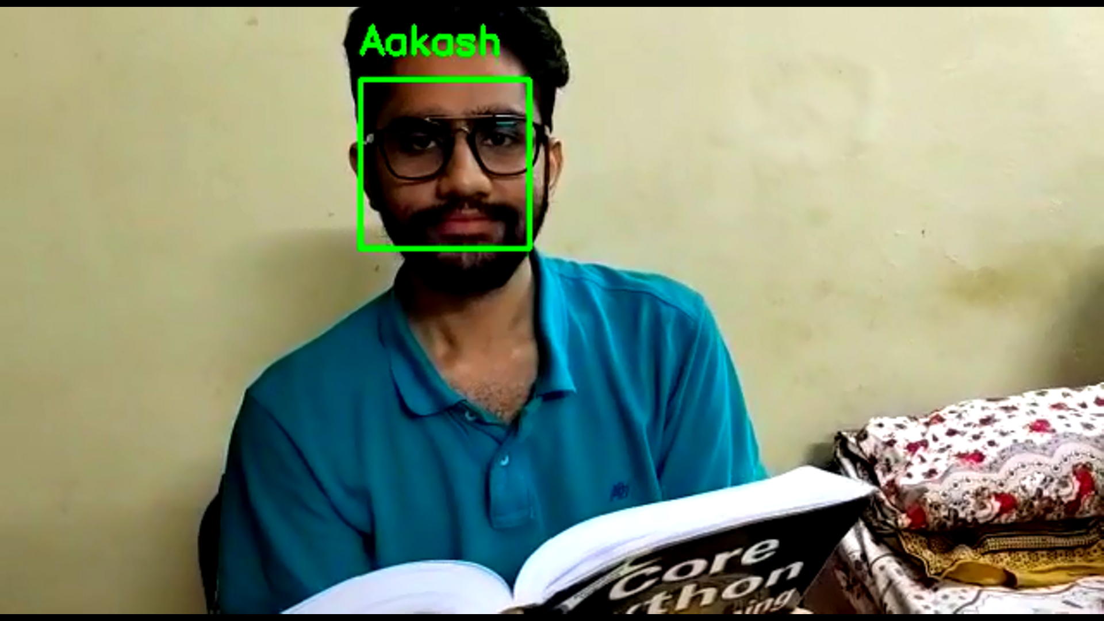
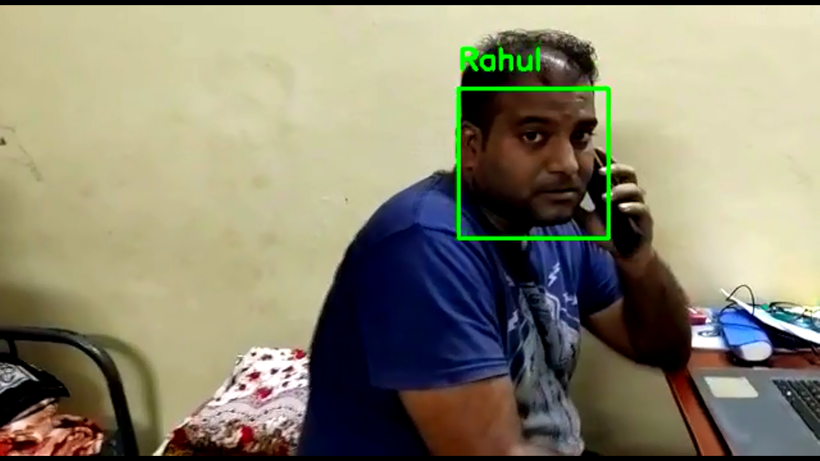
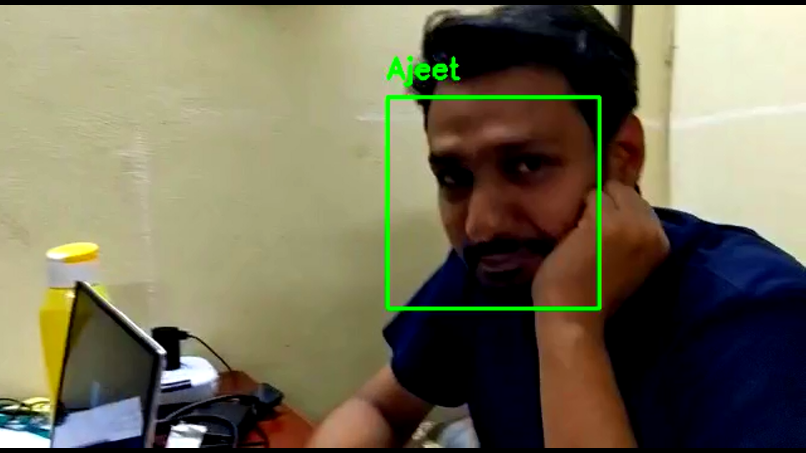
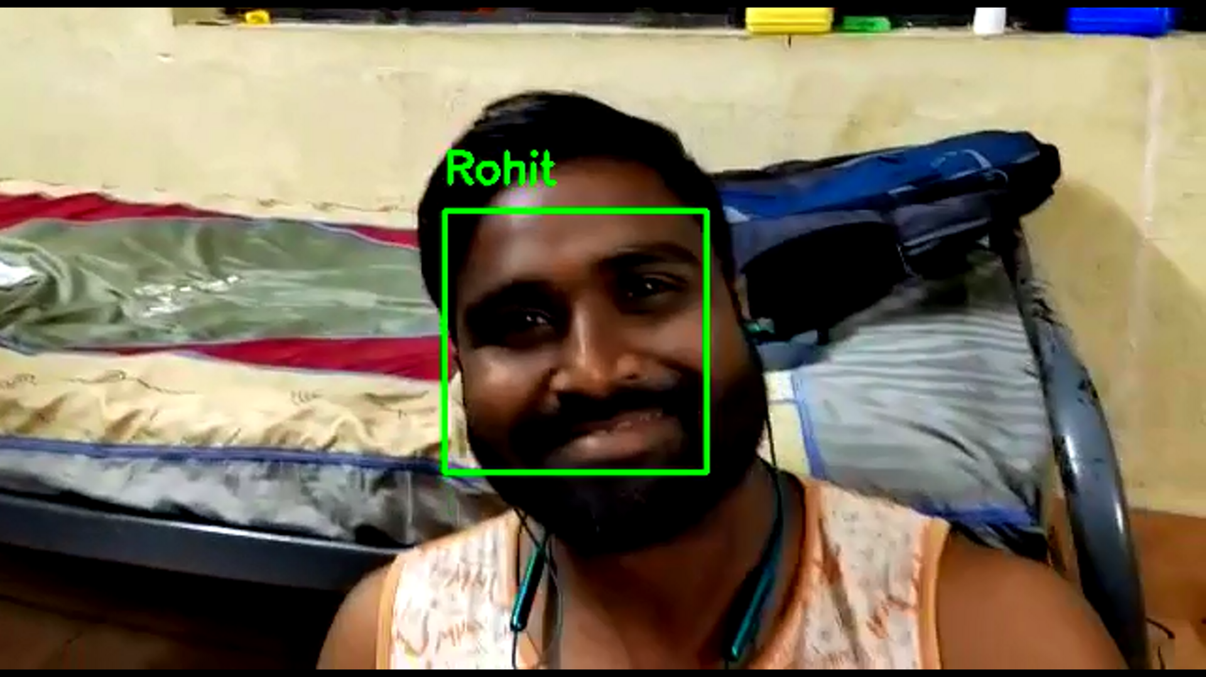
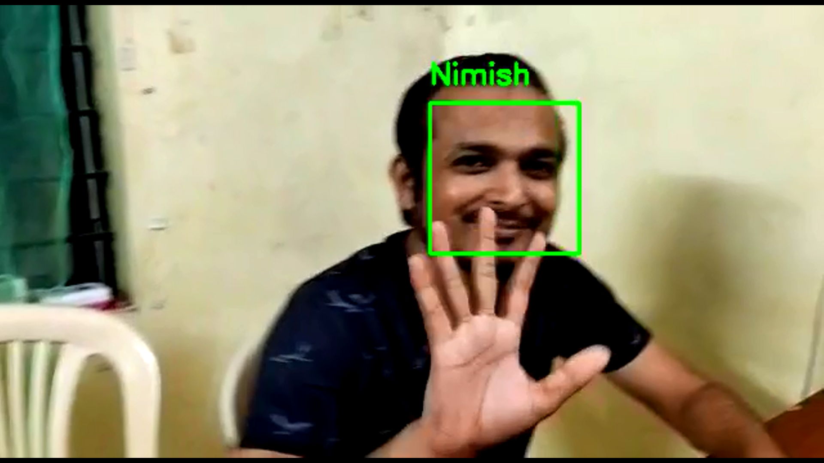
Recognize faces in video file

Slide 20
End-Use | Top Applications
Offices | Physical access to workspace facilities
Government | Helps to Identify missing children
Banking and Telecom | Help to know the current process to the customer, allow authentication of credit/debit cards
Education | Allow attendance tracking of the students and entry to labs
Construction | Control access to specific point at a site
Real Estate Commercial | Offers access to campus facilities like residence halls, common area, cafeteria, etc.
Manufacturing | Control and record access to specific locations for employees, visitors, vendors and maintenance staff
Aviation | Paperless travel at airports
Entertainment | Access to multiplex cinema

Slide 21
Conclusion
By doing this project we are trying to implement a model to recognize faces, for still images, real time video, and video file stored in our datasets
The results of the face recognition experiments are greatly influenced by:
The Training Data
The Preprocessing Function
The Type of Network selected
Activation Functions

Slide 22
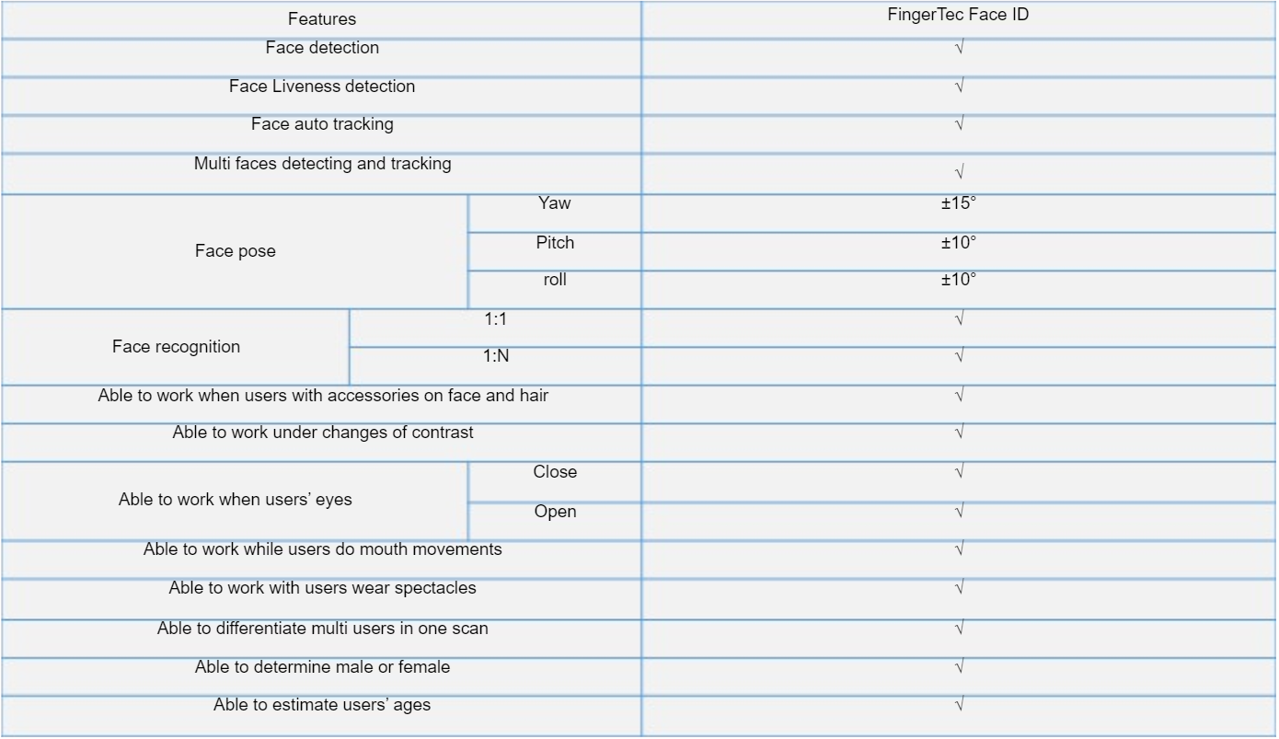
Conclusive outputs generated by the model

Slide 23
Thank you

